Slide 1
Contextualized Market Basket Analysis How to learn more from your Point of Sale Data
Presentation to: Hanesbrands
Andrew Kramer, Louisiana State University

Slide 2
Agenda
Project Overview
History of Market Basket Analysis
Downsides for retailers
Contextualized Market Baskets
SAS Demo & Code Analysis
Conclusion and Q&A

Slide 3

Project Overview
Experience in retail: desire to learn more about Market Basket Analysis
Saw an analytical need not covered in current SAS products
What are the profit implications of an association?
Created SAS Enterprise Miner Macro to add onto the results of a Market Basket Analysis:
Proc SQL
SAS Macros
Database Steps
Presented in Student Symposium at 2015 SAS South Central User Group Conference

Slide 4
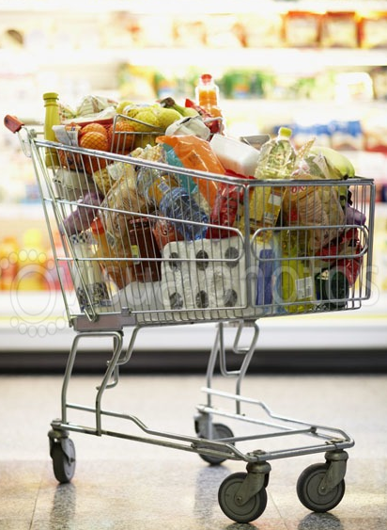
Market Basket Analysis
“Find joint values of the variables that appear frequently in the database” -Elements of Statistical Learning
Which products are commonly purchased together?
Apriori Algorithm: Only Consider relationships between commonly occurring items in dataset
Development of sophisticated predictive models such as recommender systems

Slide 5
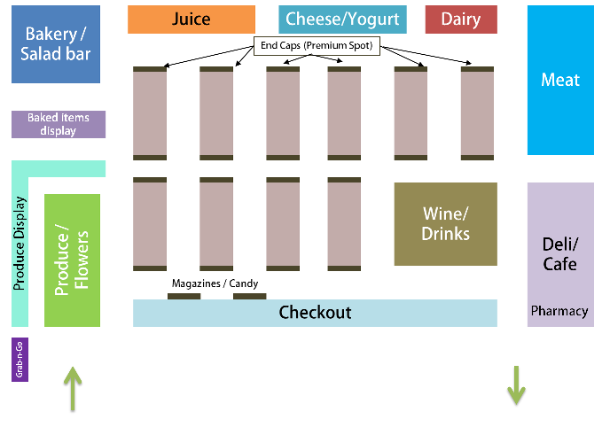
Downsides for Retailers
Fundamental Question: Do the associations create profitable, long-term relationships with customers?
Traditional Algorithms lack key data points such as Customer Id, Date, Quantity, Purchase Price, Store Location

Slide 6
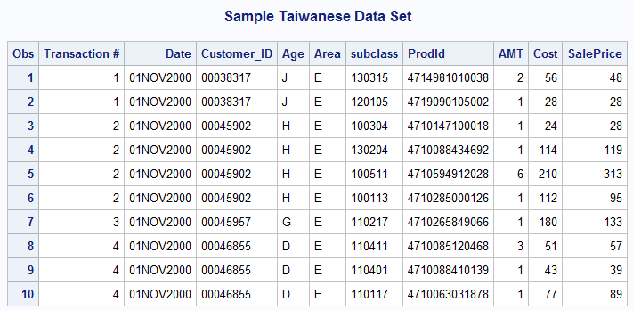
Sample Dataset
Sample Taiwanese data set from anonymous retailer
Data from November 2000 – December 2000
Transaction #: ID Variable in Enterprise Miner
Prodid: Target in Enterprise Miner

Slide 7
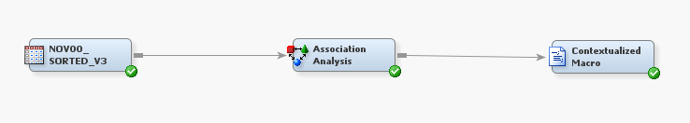
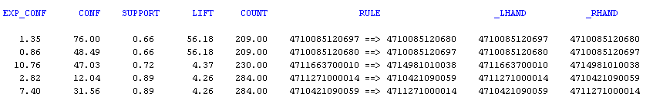
Market Basket Analysis in EM

Slide 8
Association Analysis Definitions
Expected Confidence(%): Percent of transactions that the right-hand side of the rule appears in
Confidence(%): Given that a transaction has purchased the left-hand side of the rule, what is the probability the transaction will also contain the right-hand side?
Support: Percent of transactions that contains both items in the rule
Lift(%): Confidence/Expected Confidence: Lift > 1 evidence of non-independence
Count: Number of transactions in which both the left-hand and right-hand side of the rule were purchased

Slide 9
Contextualized Market Baskets
Appends the output from the Association Analysis node based on cost using a Custom Node
Analyze the market baskets as a whole
Item-level & market-basket profitability
How size and makeup of market baskets change
Goal: Profit implications of an association
Code uses PROC SQL, Database steps, and SAS Macros to crawl the dataset and create output

Slide 10
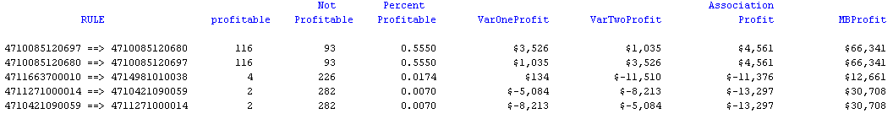
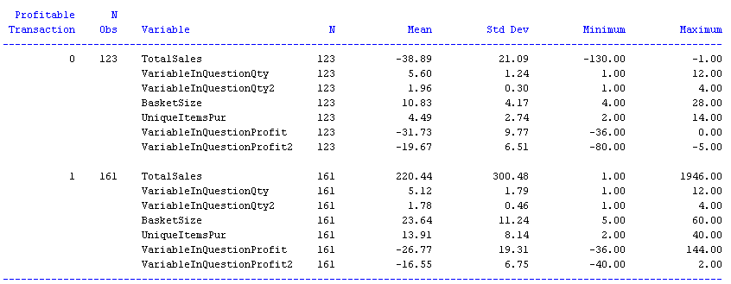

Macro Output
Appended Association Analysis Output
Contextual output for each Rule (Rule 5 Shown)

Slide 11
Rule 5 Analysis
Eggs ==> Butter
Total Market Basket Analysis
On Average, Profitable transactions:
Buy 13 more items
Are $260 more profitable per transaction
Purchase fewer items sold at a loss

Slide 12
Code Breakdown
Utilizes PROC SQL, Data Steps, and SAS Macros
Can use strategies to implement in Base SAS
PROC SQL;
SELECT count(_LHAND)
INTO :rules
FROM &EM_IMPORT_RULES;
QUIT;
Macro variables to extract the number of rules and the SKUs that make up each rule
PROC SQL;
CREATE Table varlist AS
SELECT _LHAND, _RHAND
FROM &EM_IMPORT_RULES;
QUIT;
DATA _NULL_;
SET VARLIST;
id=_N_;
CALL SYMPUT('ids'||left(put(id,20.)), _LHAND);
CALL SYMPUT('idst'||left(put(id,20.)), _RHAND);
RUN;

Slide 13
Code Breakdown
DATA Nov00_Analyzed;
SET &EM_IMPORT_TRANSACTION;
BY ID;
IF first.ID THEN DO;
TotalProfit=0;
BasketSize=0;
VariableInQuestionProfit=0;
VariableInQuestionProfit2=0;
VariableInQuestionQty=0;
VariableInQuestionQty2=0;
END;
IF prodid="&&ids&i" THEN DO;
VariableInQuestionProfit+(AMT*(SalePrice-Asset));
VariableInQuestionQty+1;
END;
IF prodid = "&&idst&i" THEN DO;
VariableInQuestionProfit2+(AMT*(SalePrice-Asset));
VariableInQuestion2Qty+1;
END;
TotalProfit+(Amt*(SalePrice-Asset));
Basketsize+AMT;
IF TotalProfit GT 0 THEN ProfitableTransaction=1;
ELSE ProfitableTransaction=0;
IF last.ID and VariableInQuestionQty GT 0 AND VariableInQuestionQty2 GT 0;
1
2
3
4

Slide 14
Code Breakdown
1. Set counter variables to zero at the start of each new transaction ID
2. Evoke the variables “ids” and “idst” for the correct loop count as defined by “i”. If the pointer reads a row showing the purchase of one of the two SKUs evoked by the macro, the code will generate summary statistics for the SKU
3. Defines variables representing the profitability and basket size of each transaction
4. Extracts the calculated fields into a new data set with one row for each transaction in which both SKUs were listed

Slide 15
Code Breakdown
%MACRO AllSubs;
%DO i=1 %TO &rules;
%DsCrawl
%ProfitTrans
%DatasetUse
%REPORT
%END;
%MEND AllSubs;
Run the DO loop once for each rule and appends the results to an empty dataset. The Report feature merges this new dataset with the results from the EM Association Analysis

Slide 16
Conclusion
This macro is designed to show the profit implications of an association
Currently only works with two SKUs, but could be modified to handle a larger number of SKUs
Importance of analyst and managerial input
Any Questions?
Contact Information:
Andrew.kramer526@gmail.com

